Slide 1
GEO AquaWatch
Strengthening Confidence in EO Water Quality Data
Steven Greb Director, GEO AquaWatch and University of Wisconsin, Madison, WI. USA
Paul DiGiacomo Chief, Satellite Oceanography and Climatology Division NOAA College Park, MD. USA
Merrie Beth Neely Scientific Coordinator GEO AquaWatch, Clearwater, FL. USA
Emily Smail Executive Director, GEO Blue Planet Initiative. NOAA, College Park, MD. USA
Arnold Dekker Director, SatDek Pty Ltd. Canberra, Australia

Slide 2
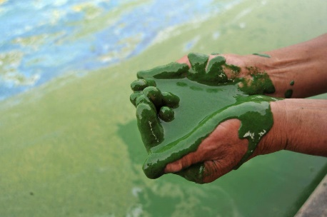
AquaWatch Impetus
Water Quality is a critical global issue today
Earth imagery sources represent rich, underutilized trove of information.
EO can have a signiﬁcant impact on framing issues and driving changes in policies and management practices
New and improved sensor technologies, novel algorithm development, image availability and processing capabilities have resulted in major advancements in remote sensing of coastal and inland waters
Still Institutional Barriers to use
Need to build trust and success stories with the end user community
In a survey conducted by EPA, “Almost unanimously, interviewees wanted assurance that the satellite product could be validated and include reported accuracy or error estimates for their particular waterbodies. Interviewees agreed that if a product was proved to provide an accurate measure in their particular waterbody of interest, they would be open to using those products for their monitoring, research, and assessments.” (Schaeffer et al 2013)
Photo by REUTERS/Stringer
Notes:
We all know about the plethora of data being generated daily now. We also know as this relatively new data source evolves , it s going to be used to frame issues and guide policy and management.

Slide 3
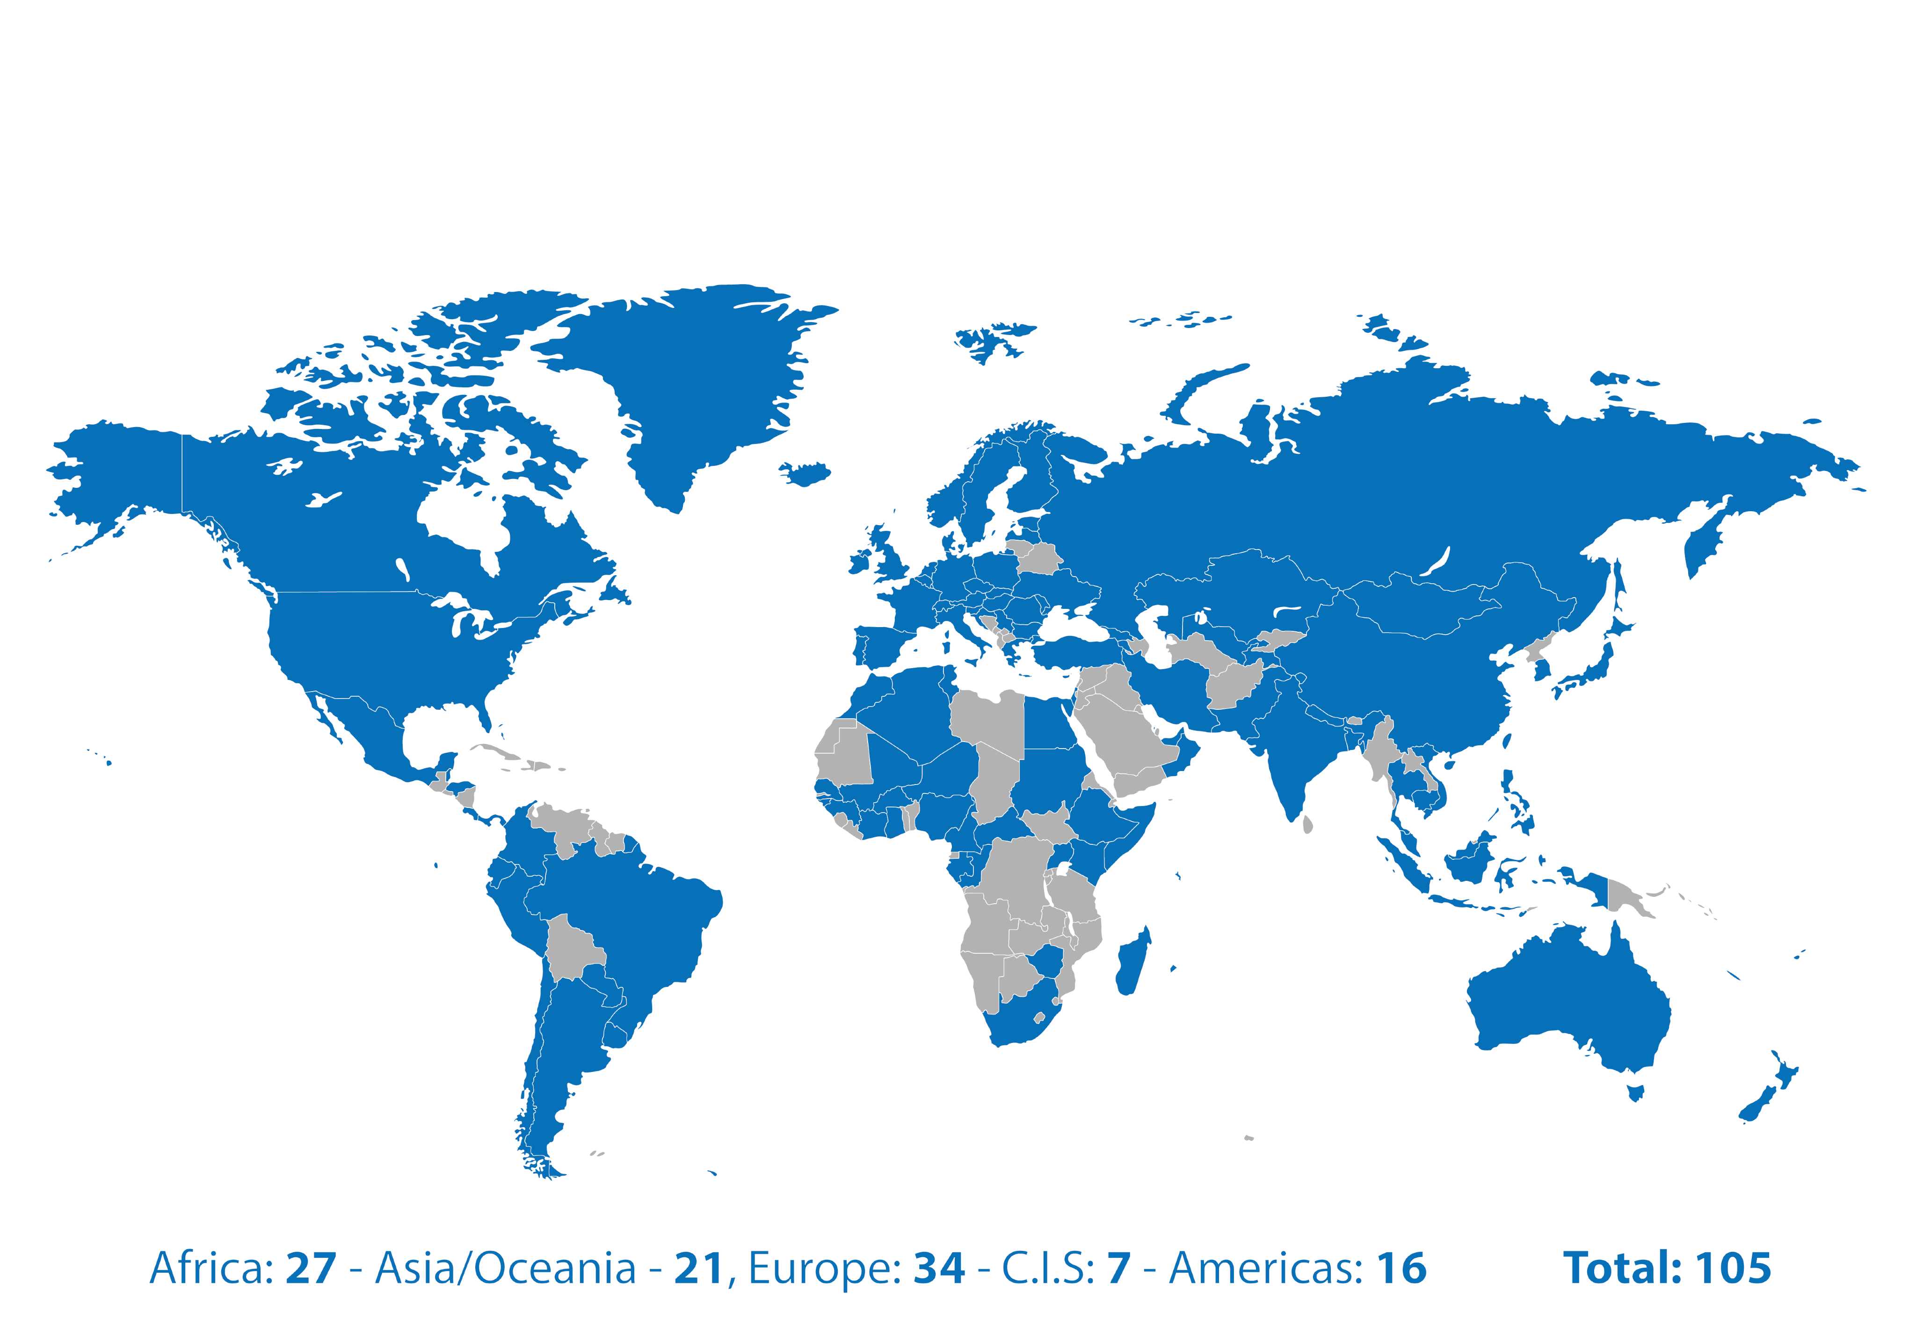
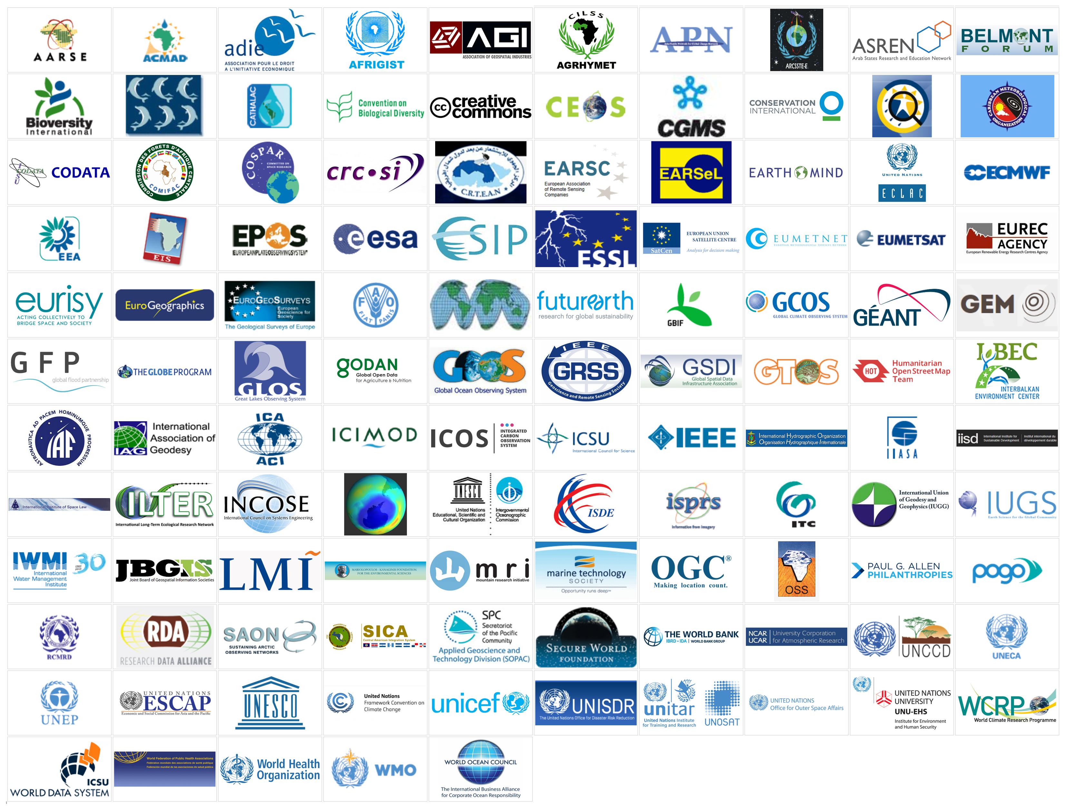
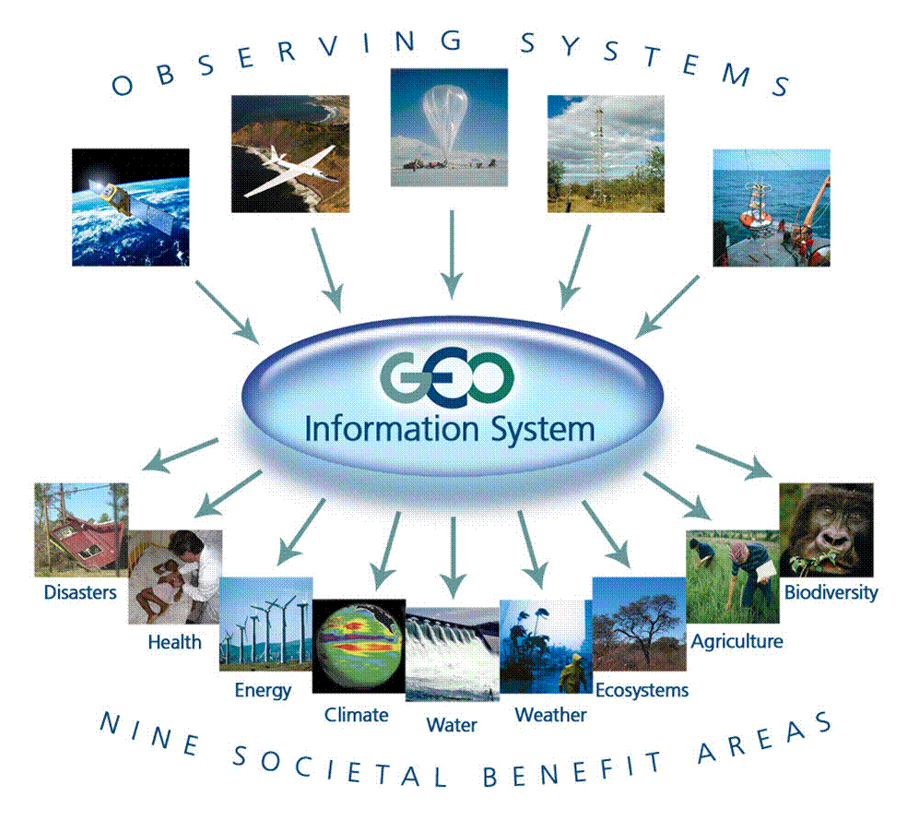
Group on Earth Observation
GEO is an intergovernmental organization working to improve the availability,
access and use of Earth observations for the benefit of society
Notes:
GEO is a large intergovernmental org with over 100 member countries, NGOs, companies, and intergovernmental orgs.

Slide 4
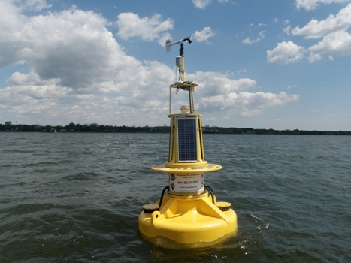
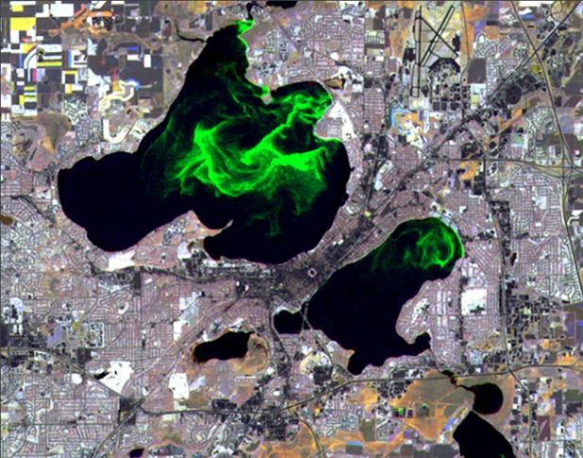
GEO AquaWatch Goal
AquaWatch aims to develop and build the global capacity and utility of Earth Observation-derived water quality data, products and information to support water resources management and decision making.
Chesapeake Bay Buoy – NOAA Image
Lakes Mendota & Monona -University of Wisconsin SSEC image

Slide 5
AquaWatch Organizational Model
Communication Coordination Collaboration
Water Quality Information Service
Outreach and End User engagement
Products and Information
Distribution, Access and Visualization
Education and Capacity Building
Observations and Data
Notes:
We have five working groups (dark red) addressing 5 components in the data stream we have around 300 members

Slide 6
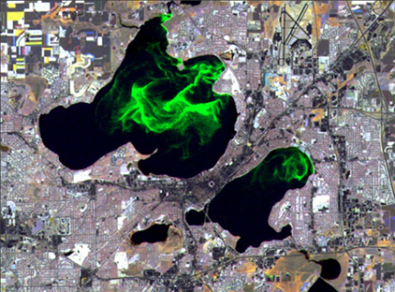
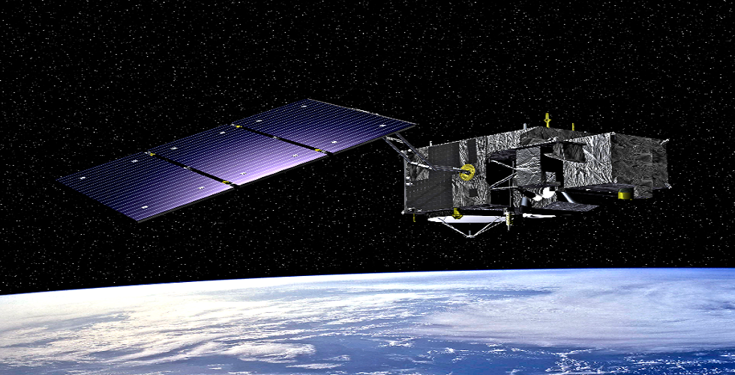
Current AquaWatch Activities To Strengthen Confidence in EO Water Quality Data
Aquatic Analysis Ready Data
Compiling Existing Data Sets (RealEarth Portal)
Generating New Data Sets (Google Earth Engine)
Coordination of Global Validation Efforts
Development of Knowledge Hub
Notes:
Highlight 5 current AquaWatch activities.

Slide 7
Current AquaWatch Activities To Strengthen Confidence in EO Water Quality Data
Analysis Ready Data satellite data that have been processed to a minimum set of requirements and organized into a form that allows immediate analysis with a minimum of additional user effort and interoperability both through time and with other datasets.
------------------------------------------------------------------------
Increases the use and impact of satellite data and removes the data preparation burden for less experienced data users
Promotes data quality and consistency through defined specifications
Aquatic Analysis Ready Data
Compiling Existing Data Sets (RealEarth Portal)
Generating New Data Sets (Google Earth Engine)
Coordination of Global Validation Efforts
Development of Knowledge Hub

Slide 8
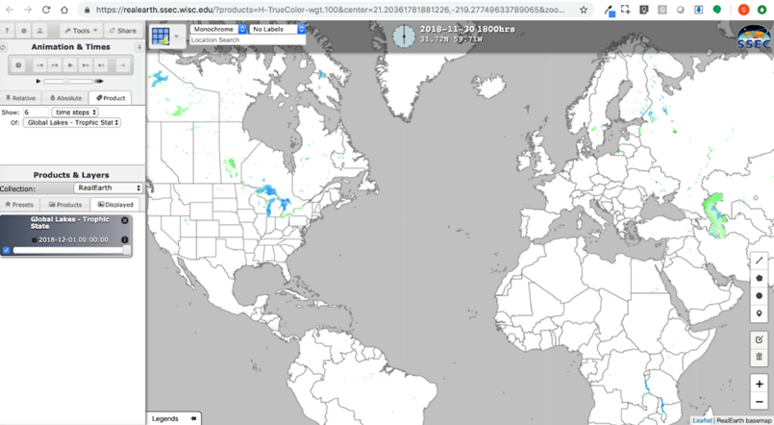
Current AquaWatch Activities To Strengthen Confidence in EO Water Quality Data
Aquatic Analysis Ready Data
Compiling Existing Data Sets (RealEarth Portal)
Generating New Data Sets (Google Earth Engine)
Coordination of Global Validation Efforts
Development of Knowledge Hub
Bring together data of varying file formats, naming conventions, and columns, and transforming it into one cohesive data set
Grab samples, buoy data, satellite products
Visual display, time series, scroll across sources for data comparison
Embedded in AquaWatch Website and linked to GEOSS
Updated hourly

Slide 9
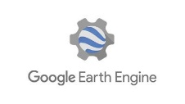
Current AquaWatch Activities To Strengthen Confidence in EO Water Quality Data
Aquatic Analysis Ready Data
Compiling Existing Data Sets (RealEarth Portal)
Generating New Data Sets (Google Earth Engine)
Coordination of Global Validation Efforts
Development of Knowledge Hub
Development of Global Water Quality Geospatial Products and Tools
A collaborative project between GEO AquaWatch, the World Bank, Conservation International, UNESCO and Google Earth Engine
The goal of this project is to provide a global-scale, open access, freely available fit-for-purpose chlorophyll-a, total suspended solids and colored dissolved organic matter (CDOM) water quality information for inland and coastal waters to be used by multiple end users including the science community, water resource managers, industry and the general public.

Slide 10
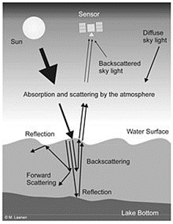
Current AquaWatch Activities To Strengthen Confidence in EO Water Quality Data
Aquatic Analysis Ready Data
Compiling Existing Data Sets (RealEarth Portal)
Generating New Data Sets (Google Earth Engine)
Coordination of Global Validation Efforts
Development of Knowledge Hub
Validation of Satellite-derived Optical and Water Quality Parameters for Coastal and Inland Waters
A NASA sponsored workshop
Goal: To build a global-scale validation network
The workshop will cover a number of aspects related to validation including standardization of protocols, instrumentation needs, current validation research and operational efforts, validation metrics, interoperability of validation data.
Experts within both the remote sensing and in situ observational community
Tentatively Set for June 2021!

Slide 11
Current AquaWatch Activities To Strengthen Confidence in EO Water Quality Data
Capacity Building and Training Effort
A web-based resource where a compilation of documentation and tools are accessible and freely open to all in the water community.
This will be a place where people from around the globe, working across this subject matter, go to exchange knowledge,
experiences, ideas,
and increase one’s
expertise.
Aquatic Analysis Ready Data
Compiling Existing Data Sets (RealEarth Portal)
Generating New Data Sets (Google Earth Engine)
Coordination of Global Validation Efforts
Development of Knowledge Hub
Resource types | Sources
Publications | Post-prints with DOI stored
Code, models and tools | Open source in Github with DOI. Backups.
Remote sensing data | GEOSS Platform and/or Cloud descriptions
In situ data | GEOSS Platform, Data Repository, and/or KH database
Results and products | GEOSS Platform, Data Repository, and/or KH database
Videos, Other | Directly stored in the Knowledge Hub (preferably).
Fair Standards
Findable
Accessible
Interoperable
Reuseable

Slide 12
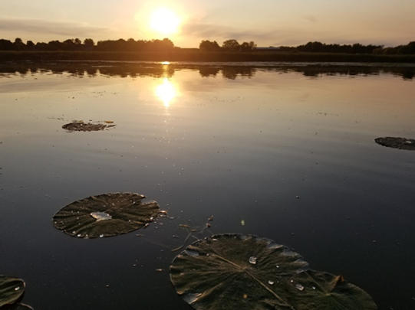
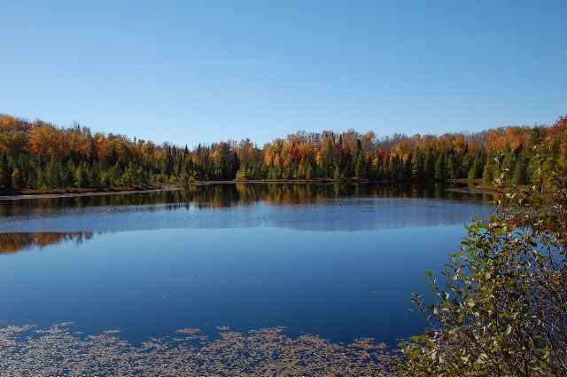
Summary
Water Quality continues to be a critical issue locally and globally
Multiple streams of Water Quality data products generated on a daily basis.
Acceptance of this new technology will require data quality assurances
GEO AquaWatch is providing an important platform and forum at a critical time to address these needs
Yahara River, WI. Credits: S. Greb/U. Wisconsin
WDNR photo

Slide 13
Contact Information
If interested in joining a working group or getting involved in AquaWatch, please contact the AquaWatch Secretariat (Merrie-Beth Neely) at info@aquawatch.org
Or contact Steven Greb, AquaWatch Director at the University of Wisconsin at
srgreb@wisc.edu
Visit our website :
www.geoaquawatch.org

Slide 14
Comparison of Earth observation sensors
Comparison of Earth observation sensors suitable for water quality assessment with public access data policy
 | Landsat-7 | Landsat-8 | Sentinel-2 | Sentinel-3
Satellite and sensor details
Satellite sensor system | ETM+ | OLI/TIRS | MSI | OLCI
Spatial resolution (m) | 15, 30, 60 | 15, 30, 100 | 10, 20, 60 | 300
Spectral Bands | 8 | 11 | 12 | 21
Revisit cycle (days) | 16 | 16 | 5 | 2
Swath width (km) | 185 | 185 | 290 | 1270
Launch date | April 1999 | February 2013 | June 2015 | Feb 2016
Years in orbit/minimum design life (years) | 18/5 | 4/5 | 2/7 | 1/7
Suitability for water quality assessment -Highly Suited; -Suitable; -Potential
CHL |  |  |  | 
CYP |  |  |  | 
TSM |  |  |  | 
CDOM |  |  |  | 
SD |  |  |  | 
K_{d} |  |  |  | 
CHL – Chlorophyll, CYP – Cyanophycocyanin, TSM – Total Suspended Matter, CDOM – Colored Dissolved Organic Matter, SD – Secchi Disk Transparency, K_{d} – Vertical Attenuation of Light
Suitability for water quality assessment from Dekker, A.G. & Hestir, E. L. (2012) Evaluating the Feasibility of Systematic Inland Water Quality Monitoring with Satellite Remote Sensing. CSIRO: Water for a Healthy Country National Research Flagship

Slide 15
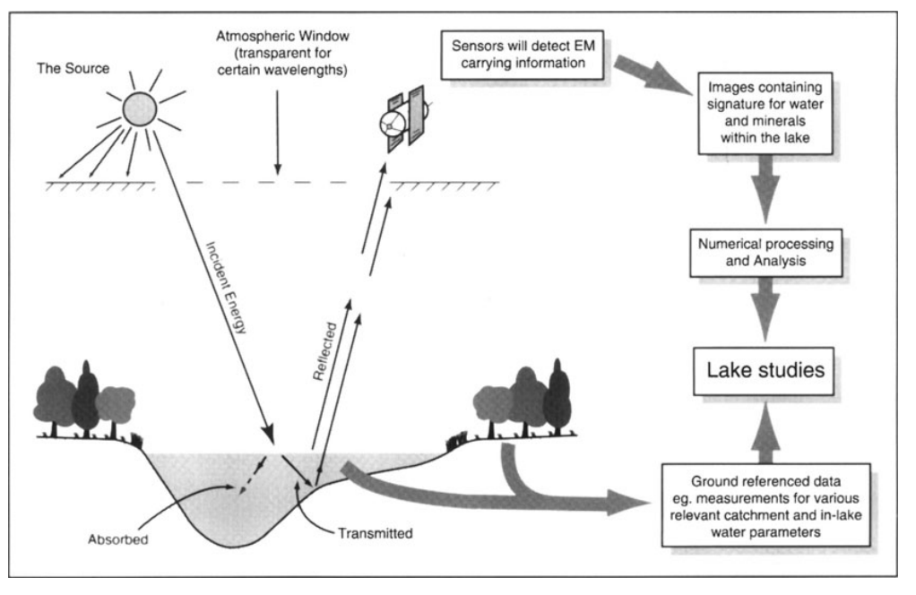
From Baban, 1999

